Slide 1
HATE SPEECH DETECTION SYSTEM
Using Machine Learning and Natural Language Processing
Mini Project Work (PCA20P02L)
Presented by : HIMANI TYAGI Registration No: RA2432241030001 Branch: MCA - 3rd Semester / 2nd Year
Under the Guidance of: Dr. Lalit Kishore, Assistant Professor(HOD) Project Coordinator: Dr. Rupak Sharma, Associate Professor

Slide 2
PROBLEM STATEMENT & MOTIVATION
THE CHALLENGE
• Explosive growth of social media content • Manual moderation cannot scale to millions of posts daily • Need for automated hate speech detection
PROBLEM DEFINITION
• Distinguish between hate speech, offensive language, and neutral content • Minimize false positives and false negatives • Create scalable solution for real-world deployment
MOTIVATION
• Creating safer digital environments • Supporting human moderators with AI tools • Protecting individuals and groups from harmful content

Slide 3
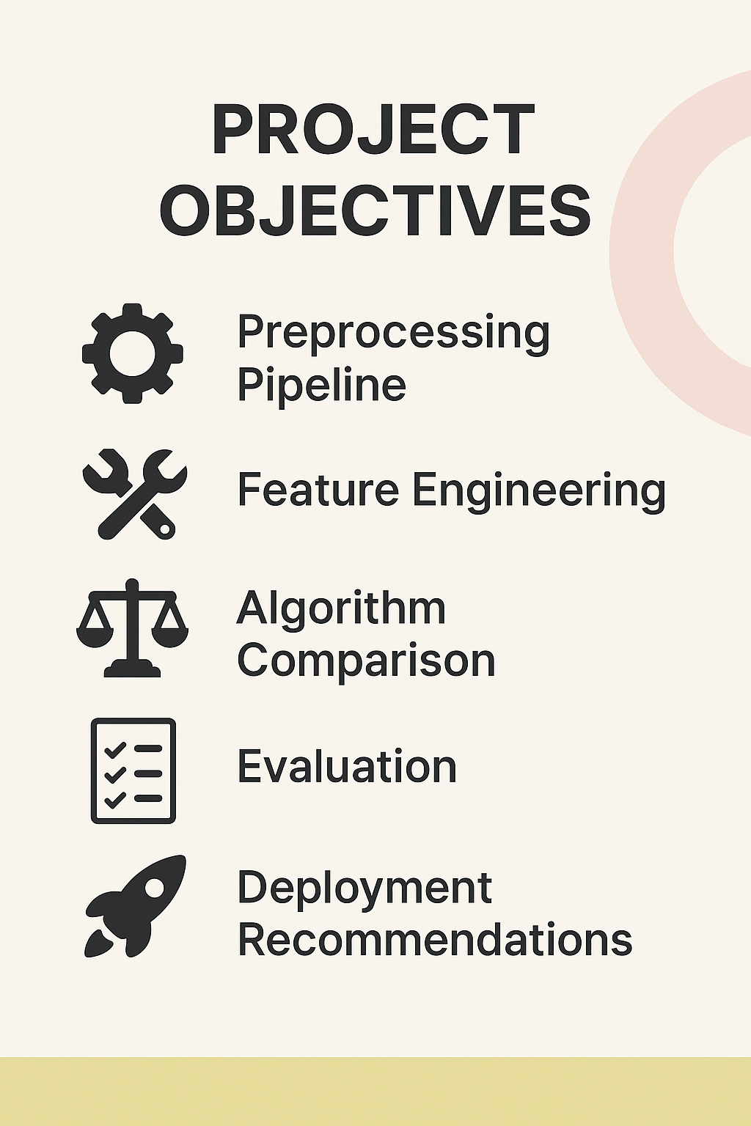
PROJECT OBJECTIVES PRIMARY OBJECTIVES 🎯 Robust Preprocessing Pipeline • Tokenization, stop-word removal, stemming, normalization 🎯 Advanced Feature Engineering • TF-IDF vectors, sentiment scores, metadata extraction 🎯 Multi-Algorithm Comparison • Random Forest, Logistic Regression, SVM, Naive Bayes 🎯 Comprehensive Evaluation • Accuracy, precision, recall, F1-score analysis 🎯 Deployment Recommendations • Performance optimization and future enhancements

Slide 4
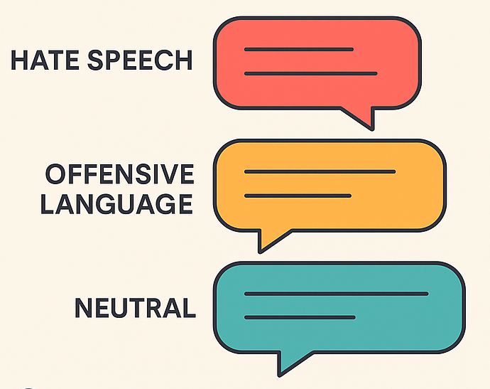
DATASET & SCOPE
DATASET SPECIFICATIONS
Source: CrowdFlower Public Dataset Size: 24,783 labeled tweets Classes: • Hate Speech • Offensive Language • Neither (Neutral)
PROJECT SCOPE
• Three-class classification system • Focus on English language text • Social media platform applicability • Prototype development for learning purposes

Slide 5
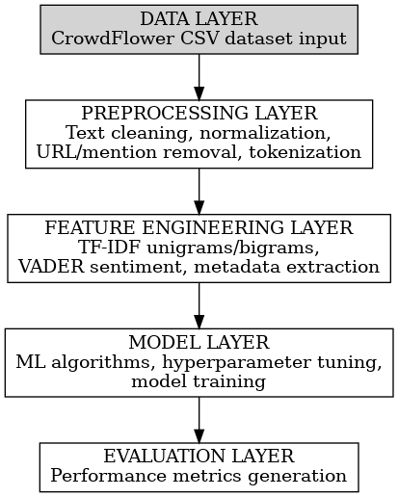
TECHNICAL ARCHITECTURE
DATA PROCESSING PIPELINE
KEY PROCESSING STEPS:
Raw Dataset → 24,783 tweets with labels
Text Preprocessing → Cleaning, tokenization, stemming
Feature Engineering → TF-IDF, sentiment, metadata
Model Training → 4 different ML algorithms
Evaluation → Performance metrics and analysis
our presentation

Slide 6
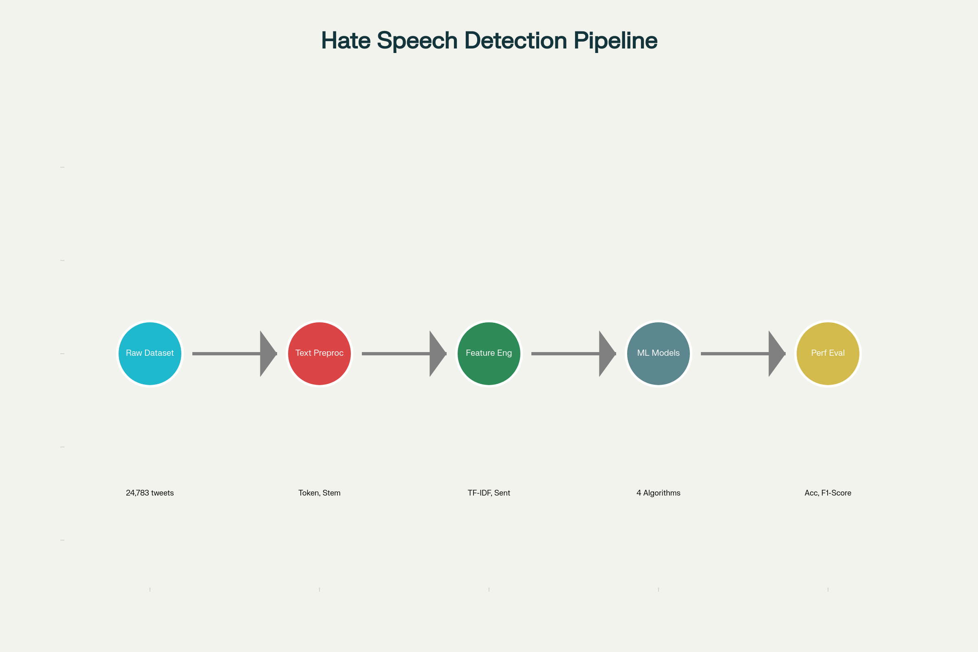
Hate Speech Detection Pipeline

Slide 7
FEATURE ENGINEERING DETAILS
FEATURE EXTRACTION TECHNIQUES
🔤 TF-IDF Vectorization • Unigrams and bigrams • Maximum 5,000 features • Captures word importance
😊 Sentiment Analysis • VADER Sentiment Analyzer • Polarity scores (positive, negative, neutral) • Compound sentiment score
📊 Metadata Features • Text length analysis • URL count, mention count, hashtag count • Reading difficulty scores
🧠 Doc2Vec Embeddings • Document vector representations • Semantic meaning capture

Slide 8
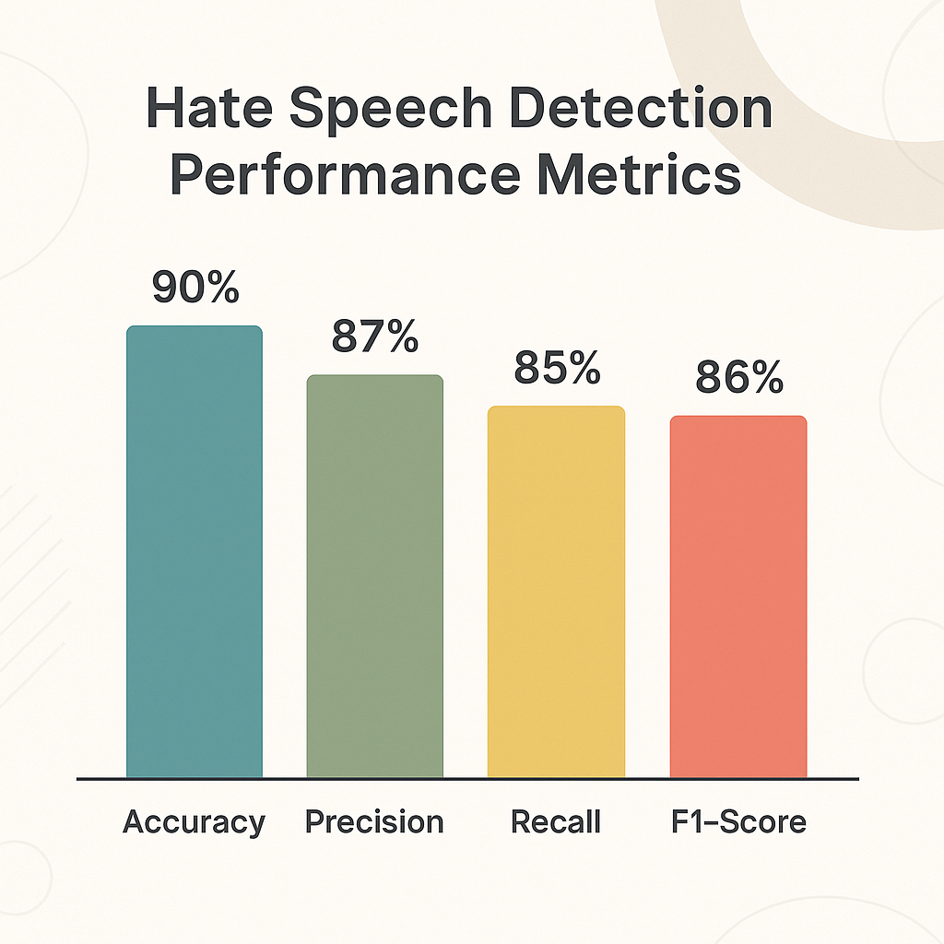
MACHINE LEARNING MODELS & RESULTS
Algorithm | Accuracy | Key Strengths
Random Forest | 93% | Highest accuracy, robust
Logistic Regression | 91% | Consistent performance
SVM | 89% | Good generalization
Naive Bayes | 85% | Fast, baseline model
Key Finding: Random Forest achieved the best overall performance

Slide 9
KEY FINDINGS & CHALLENGES
✅ ACHIEVEMENTS
• Successfully implemented end-to-end ML pipeline • Random Forest achieved 93% accuracy • Effective feature engineering approach • Comprehensive model comparison completed
⚠️ CHALLENGES IDENTIFIED
• Distinguishing hate speech vs. offensive language remains difficult • Context and sarcasm detection limitations • Cultural nuances in language interpretation • Requirement for human oversight in moderation
💡 INSIGHTS
• TF-IDF features proved most important • Sentiment scores help differentiate content types • Doc2Vec features showed limited impact

Slide 10
CONCLUSION & FUTURE WORK
PROJECT IMPACT
• Demonstrates practical application of ML and NLP • Provides framework for automated content moderation • Contributes to safer online environments
FUTURE ENHANCEMENTS • Multi-language support • Real-time processing capabilities • Cross-platform deployment
NEXT STEPS
• Complete model evaluation phase • Fine-tune hyperparameters • Prepare final documentation • Deploy prototype system

Slide 11
✨ THANK YOU ✨
Any Questions?

Slide 12
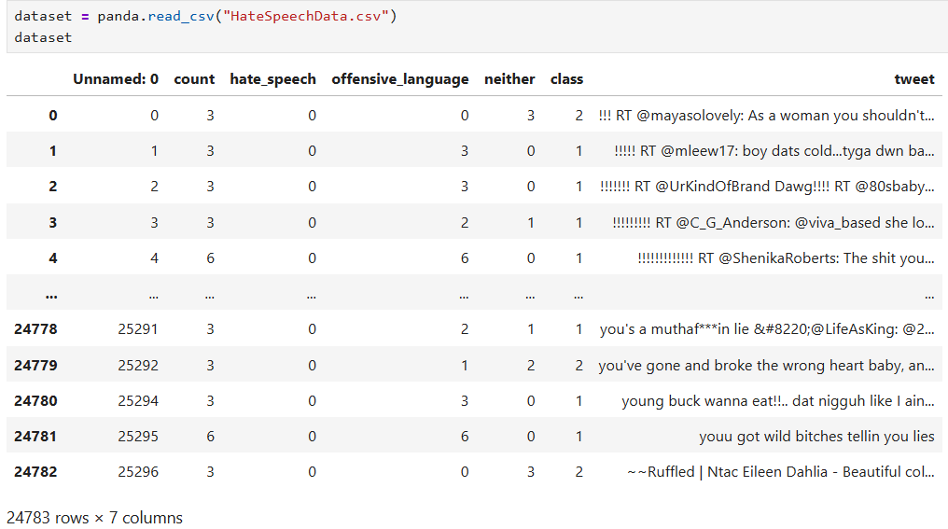
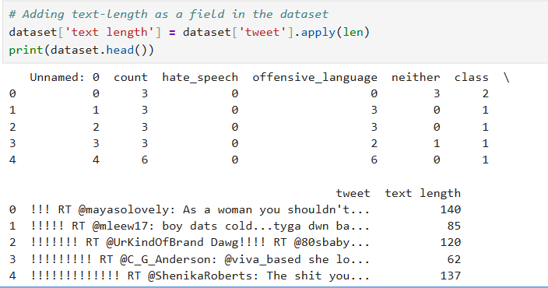
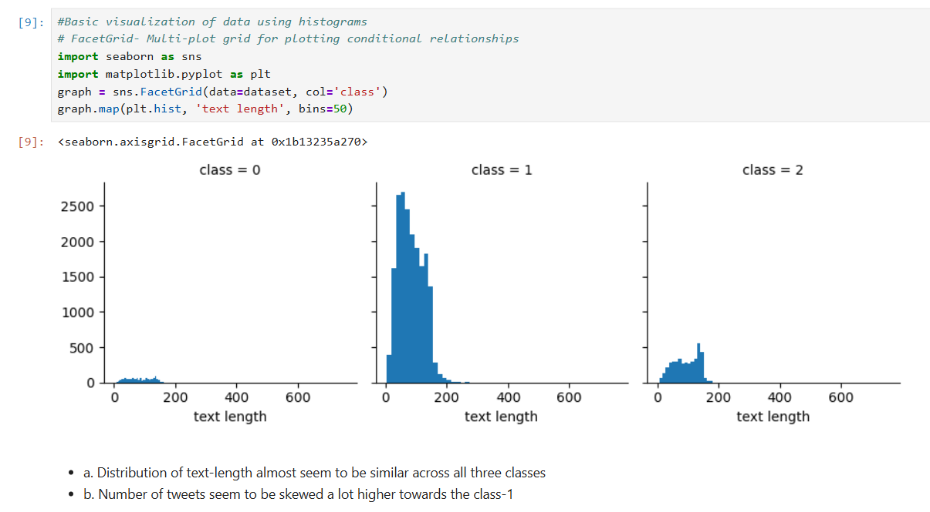
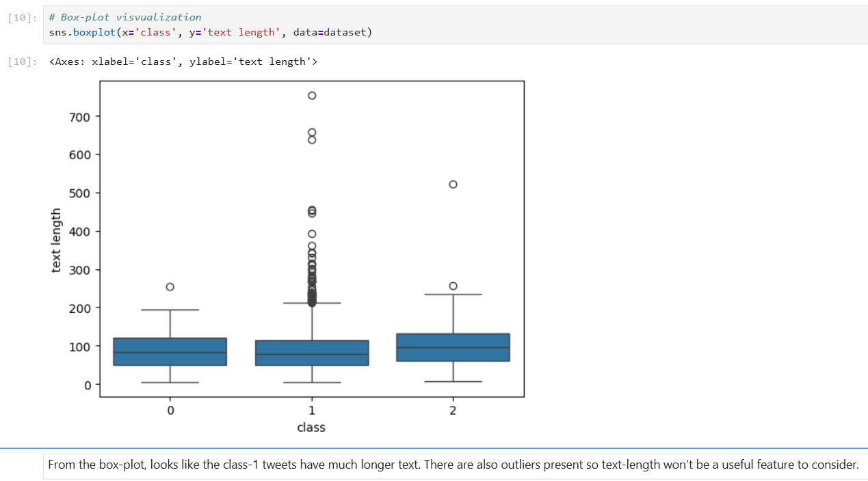

Slide 13
